Slide 1
HTML5 and CSS3
Layout & Composition
Fads come and go, but good design is timeless!

Slide 2
The Design Process
“Good design transcends technology”
The actual process of developing an entire site includes a lot of steps, but the process of creating a design “comp” boils down to only 2 tasks:
Discovery
Implementation

Slide 3
Discovery
This part of the design process is about meeting the clients and discovering what they want.
The initial client meeting is about communication. Try to listen more than you speak.
What does the company do?
What is your role in the company?
Does the company have an existing logo or brand?
What is your goal in developing a web site?
What information do you wish to provide online?
Who comprises your target audience?
Do its members share any common demographics, like age, sex, or a physical location?
Who are your competitors and do they have web sites?
If you’re a programmer, avoid the tech jargon. If you’re a designer, avoid talking specifically about design.

Slide 4
Implementation
The next step in the design process is to take what you’ve learned from the client and use it to create a design.
Regardless of the project, try not to get caught up in the technology associated with building web sites—at least not at first.
Tools used ? Pen & Paper

Slide 5
Defining Good Design
There are 2 main standpoints from which most people determine whether a web site design is good or bad.
Usability Standpoint
Aesthetic Perspective
Some designers get caught up in the aesthetics and graphics and forget about the user, and some usability gurus get lost in their user testing and forget about visual appeal. In order to reach people and retain their interest, it’s essential to maximize both.

Slide 6
Keys Points to remember….
Users recognize each page as belonging to the site
Users can move about easily via intuitive navigation
Users are pleased by the design but drawn to the content

Slide 7
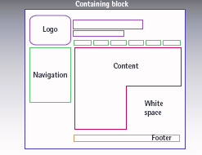
Web Page Anatomy
Most websites have the following components:

Slide 8
Containing Block
Every web page has a container.
This could be in the form of the page’s body tag, an all-containing div tag.
Without some sort of container, we would have no place to put the contents of our page. The elements would drift beyond the bounds of our browser window and off into empty space.
The width of the container can be liquid, meaning it expands to fill the width of the browser window; or fixed, so that the content is the same width no matter what size the window is.
Responsive design goes a step further than liquid layouts (covered next week).

Slide 9
Logo
The identity block that appears on the web site should contain the company’s logo or name, and sit at the top of each page of the web site.
The identity block increases brand recognition and lets users know that the pages they’re viewing are part of a single site.

Slide 10
Navigation
It’s essential that the site’s navigation system is easy to find and use. Users expect to see navigation right at the top of the page.
Whether you plan to use vertical menus down the side of the page, or a horizontal menu along the page’s top, the navigation should be as close to the top of the layout as possible.
At the very least, all main navigation items should appear “above the fold.”

Slide 11
Content
A typical web site visitor will enter and leave a web site in a matter of seconds. If visitors can’t find what they’re looking for, they will undoubtedly close the browser or move on to another site.
It’s important to keep the main content block as the focal point of a design so that precious seconds aren’t wasted as visitors scan the page for the information they need.

Slide 12
Footer
Located at the bottom of the page, the footer usually contains copyright, contact, and legal information, as well as a few links to the main sections of the site.

Slide 13
Whitespace
The graphic design term whitespace (or negative space) literally refers to any area of a page that’s not covered by type or illustrations.
While many novice web designers (and most clients) feel a need to fill every inch of a web page with photos, text, tables, and data, having empty space on a page is every bit as important as having content.
Without carefully planned whitespace, a design will feel closed in, like a crowded room.

Slide 14
Basic Web Design Concepts
There are several principles of design pertinent to the Web. Among them are proximity, alignment, repetition, and contrast. These four principles affect how Web pages are perceived.

Slide 15
Proximity
Proximity refers to the distance between elements on a Web page and how the elements relate to one another. These elements include text, navigation, headings, and so on.
Generally speaking, elements that are close together appear to have a stronger relationship than elements that farther apart.

Slide 16
Proximity

Slide 17
Proximity
If you look at the two columns of text in previous slide, you’ll notice that they look very similar.
The only difference is in the placement of the headings.
In the column on the left, the word “Unkgnome” is equi-distant from the top and bottom paragraphs. This results in a heading that looks more like a separator than a heading for the next paragraph.
In the second column, the “Gnomenclature” heading is placed closer to the paragraph that follows it. In accordance with the rules of proximity, this heading appears to belong to that block of text.

Slide 18
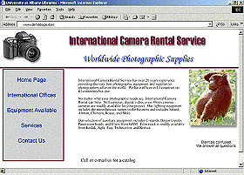
Example of Odd spacing that causes the weak layout of an illustration
Because these 2 lines of the header are so far apart, it seems almost as if they do not belong together. But the message of the header is supposed to be that the International Camera Rental Service provides photographic supplies worldwide.
This message is not as powerful as it could be because of the wide spacing.
The text should move to the left. The current position of the text causes the page to look imbalanced. Positioning the text near the photo gives the impression that it refers to the photo, which it does not.
This is a very strong photograph with lots of visual Interest. However, the overall strength of the photo is decreased because the caption below it is too far away.
When the images and captions are close together the strength of both are increased. The 2 elements combine to make a stronger statement.
The bottom line which reads, "Call or e-mail us for a catalog" is so far down on the page that it looks almost as a throwaway line.

Slide 19
Alignment
One of the most critical principles of design is alignment.
Like proximity, alignment can enhance or detract from the appearance of a Web page. But in addition, it can significantly affect the readability of material on a page.

Slide 20
Alignment
Center alignment makes finding the beginning of a new line of text much more difficult. Each line tends to be a different length. As a result it is much more tiring to read text with center alignment. The eye is constantly guessing and searching for the start point. In addition, center alignment causes odd line lengths. These odd lengths cause a sort of "choppiness" in how the text reads. It lacks the smooth flow that tends to occur with left alignment.

Slide 21
Alignment
On most printed pages in Western culture, the text is aligned left and reads from left to right.
This provides a consistent starting point for each new line. The eye of the reader becomes used to easily finding the beginning of a new line.

Slide 22
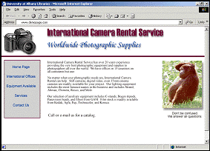
Alignment
The alignment style for an entire page, not just the text, must be selected. Proper alignment will create strong associations and a pleasing presentation.
This version of the page has improved horizontal and vertical alignments.

Slide 23
Repetition
Repetition is not only saying the same thing several times to get a point across.
It is also the use of a consistent theme throughout a Web site. While all the pages on a Web site do not have to be exactly the same, there should be enough similarities to create a consistent look and feel to the site.
This consistency is one of the things that help make a site easy to navigate.

Slide 24
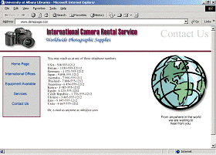
Repetition
The Contact Us page in the illustration on the right has several differences over the previous page.
The camera logo is smaller,
the header text is higher and smaller,
there is a page label in the upper right hand corner,
and there is a drawing instead of a photograph.
But, the basic design elements repeat, thus giving the page a familiar appearance and feel.
the camera logo and it's position repeat,
the navigation repeats,
the position of the image is the same as on the home page.
so although this is a different page, there is a strong sense of familiarity.

Slide 25
Contrast
Contrast works in several different ways.
Perhaps the most obvious example of contrast is the color of text against a background. It is much easier to read text that contrasts highly with the background.
This is an example of poor contrast. The color of this text is not different enough from the background color. Higher contrast is far easier to read.
This text is much easier to read than the text above.
Tests indicate that white wording on a black background is harder to read than the black text on a white background.

Slide 26
Contrast
However, contrast can also include all sorts of differences between elements. Under some circumstances, contrast is used to make something different so that it stands out. This helps to indicate what is important.

Slide 27
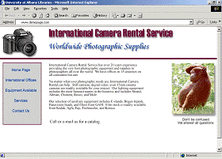
There are three examples of contrast on the page.
The header text is actually in 2 different colours: red and blue.
This helps distinguish the name of the company and its motto.
Lots of white space that contrasts with coloured elements on the page help separate the elements into understandable bits.
The center alignment of the navigation contrasts with the general left alignment elsewhere.
This helps the navigation standout by making it different.

Slide 28
Balance
There are many ways to create balance when designing an HTML page.
The simplest type is a formally or symmetrically balanced page.
This occurs when the right side is nearly identical to the left side of the page (or the top and bottom of the page are similar to each other).

Slide 29
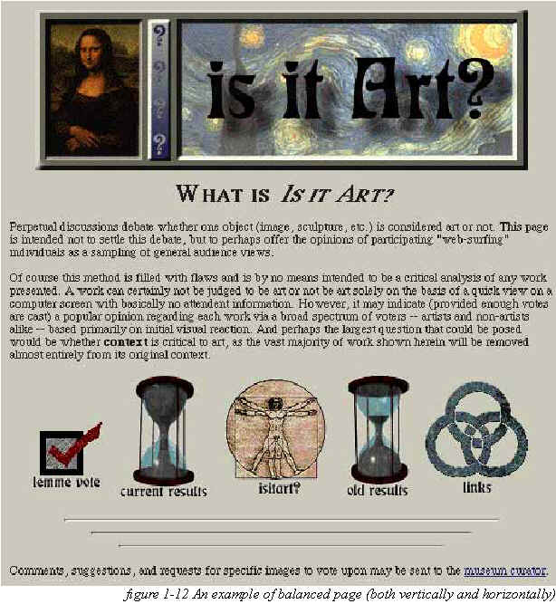
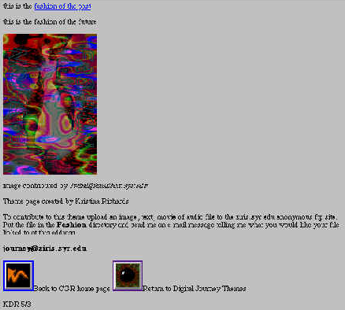

Slide 30
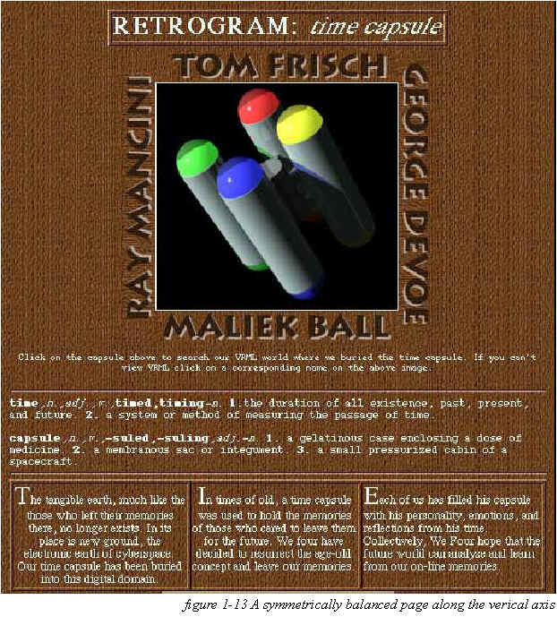

Slide 31
Asymmetrical Balance
Asymmetrical balance, or informal balance, is a little more abstract, and generally more visually interesting, than symmetrical balance.
Rather than having mirror images on either side of the layout, asymmetrical balance involves objects of differing size, shape, tone, or placement.
These objects are arranged so that, despite their differences, they equalize the weight of the page. If you have a large object on one side of a page, and you partner it with several smaller items on the other side, the composition can still feel balanced.

Slide 32
Asymmetrical Balance

Slide 33
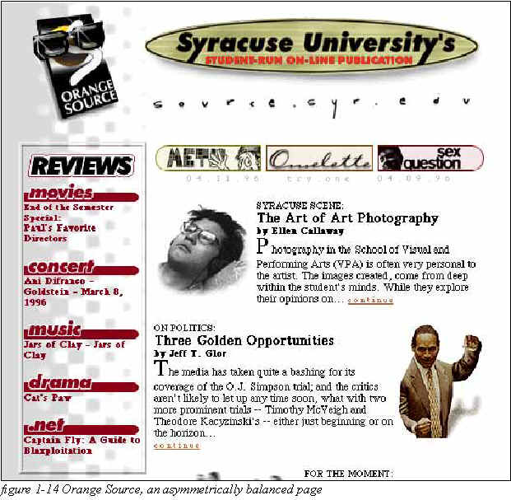

Slide 34
Layouts
We’ll now look at the most common layouts, and explore some of their advantages and disadvantages.

Slide 35
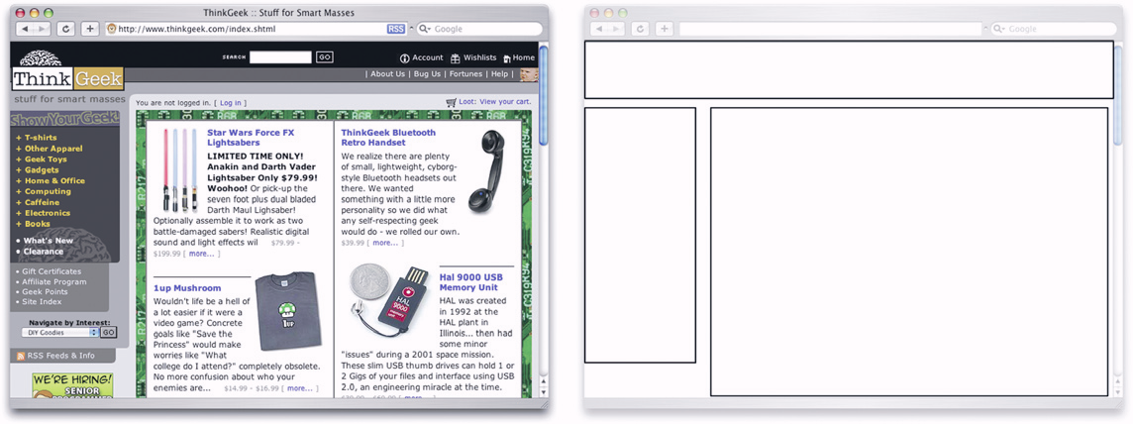
Left-column Navigation
Regardless of whether we’re talking about liquid or fixed-width layout design, the left-column navigation format is the de facto standard.

Slide 36
Left-column Navigation
Many sites that fit into this mold don’t necessarily use the left column as the main navigation block—sometimes you’ll see the navigation along the top of the page—but they still divide the layout below the header into a narrow (one-third or less) left column and a wide right column.
The downside to sites that use left-column navigation is that they can lack creativity.

Slide 37
Right-column Navigation
Although it’s difficult to find sites like Audi’s that place the main site navigation along the right-hand side of the layout, it’s quite easy to find sites that use a right-hand column for sub-navigation, advertising, or sub-content.
Since, in western cultures, our eyes scan from left to right, this allows the page’s main content to be the first thing viewers see.

Slide 38
Right-column Navigation

Slide 39
Three-column Navigation
The typical three-column layout has a wide center column flanked by two diminutive navigational columns.
The Apple Store web site shown next is an example of this common web page layout staple.
Although three columns may be necessary on pages that have a ton of navigation, short bits of content, or advertising to display, it’s important to remember that whitespace is essential if we are to keep a layout from appearing cluttered.

Slide 40
Three-column Navigation

Slide 41
Fresh Trends: Expansive Footer Navigation
If you scroll to the bottoms of pages on many of the most recently redesigned sites, you’re likely to see an interesting new trend.
Rather than using the footer for main links and a copyright notice, many sites are expanding this neglected piece of page real estate to include contact information, expanded site navigation, and extra content.
Although putting a site’s main navigational element at the bottom of the page isn’t a good idea, the concept of including “bonus” navigation and content in that space has taken off lately.

Slide 42
Expansive Footer Navigation

Slide 43
Fresh Trends: Three Columns with Content First
By first, I mean they’re locating the content on the far left of the display.

Slide 44
Webpage layout size
When creating a web page, keep in mind that web users rarely scroll past the first screen. Depending on monitor size, resolution and the users browser settings, this means you are working with a very small area.
You will have to get your visitors attention or gain their interest with the content you display there. (If visitors do scroll, it is usually only 3 screen-fulls worth or 2 clicks on their scroll bar so make sure your pages are not too long.)

Slide 45
Headings and focal points in webpage layout
Web visitors also ''skim'' web pages looking at the headings and focal points rather than reading paragraphs. If the headings interest them, then they read the smaller text. If the focal points happen to be links to things they want to find out more about, they will click on those links.
The index/home page needs to have a layout that allows the visitor to find out as much as possible about your website at a glance without overwhelming them.

Slide 46
Fixed- vs. liquid-width layouts—the pros and cons
 | Pros | Cons
Fixed-width | designer has more control over how an image floated within the content will look allows for planned whitespace narrower text blocks improve readability | can appear dwarfed in large browser windows takes control away from the user
Liquid-width | adapts to most screen resolutions and devices reduces user scrolling | text spanning a wide distance is more difficult to read more difficult to execute successfully can cause a lack of, or awkward, whitespace

Slide 47
Testing
Test your website as you go along.
If you’re in the computer lab and there’s an empty computer next to you, log into it and check out your web page from there
Make sure it works in Chrome and Internet Explorer, Firefox
Make sure all pictures come up on a different machine
Check your page on different screen resolutions

